Slide 1
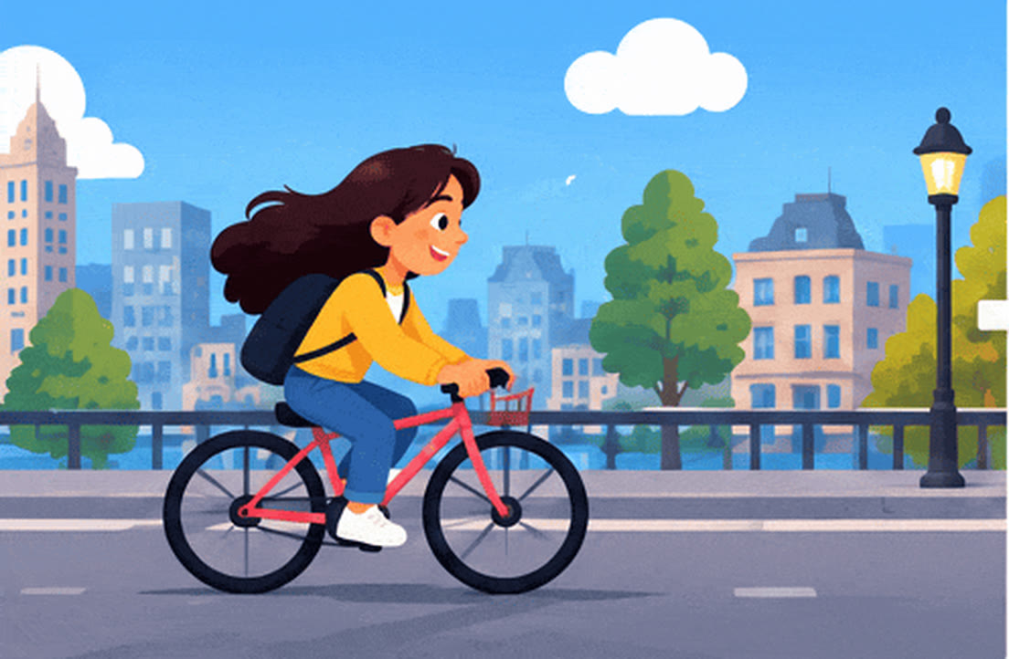
MÜNSTERHACK 2026
Who has ever had a Bike stolen?
Notes:
0:00–0:10. The animation loops while you walk on. Pause, then: "Hands up if you've ever had a Leeze stolen." Wait two seconds. "Keep your hand up if you got it back." Most hands go down. Move to the next slide.

Slide 2

MÜNSTERHACK 2026 · THE PROBLEM
Bike theft in Münster, 2025
4,561
1 in 7
12.6%
of all reported crimes
solved by the police
#1 in Germany
≈ €5.8 M
≈1,500 thefts per 100,000 residents
lost per year (4,561 × €1,270 average)
bikes reported stolen
The police bike-pass app was discontinued, and Münster's online bike registration no longer exists.
Sources: Polizei Münster, Kriminalstatistik 2025 · bikepass.eu (PKS 2025) · polizei-dein-partner.de · €5.8 M is our estimate
Notes:
0:10–0:40. "In 2025, over 4,500 bikes were reported stolen in Münster. That's one in seven of all reported crimes, and only one in eight cases gets solved. Per resident, no city in Germany loses more bikes than we do. That's roughly 5.8 million euros a year. And the tools that should help are gone: the police bike-pass app was discontinued, and online registration in Münster no longer exists." Say the numbers slowly.

Slide 3
OUR ANSWER
LeezenPass
The digital bike pass for Münster: making stolen Leezen hard to sell.
MÜNSTERHACK 2026 · TEAM
Adarsh · Niharika · Viola · Frank · Phillip
Notes:
0:40–1:00. "That's the problem we worked on this weekend. I'm Adarsh, and together with Niharika, Viola, Frank and Phillip we built LeezenPass: a digital bike pass for Münster that makes stolen Leezen hard to sell."

Slide 4



LEEZENPASS · THE INSIGHT
Bikes get stolen because they are easy to sell.
LeezenPass makes them hard to sell.
Deter
Verify
Recover
Registered, coded bikes with a visible tag are hard to resell.
Buyers check the frame number; sellers hand over ownership digitally.
A public stolen list, and the community helps bring bikes home.
Notes:
1:00–1:30. "Bikes get stolen because they're easy to sell. So we don't build a better lock. We make stolen bikes hard to sell. LeezenPass does three things: it deters, because registered bikes are hard to resell; it lets buyers verify a bike before they buy; and it helps owners recover stolen bikes. Let me show you."

Slide 5
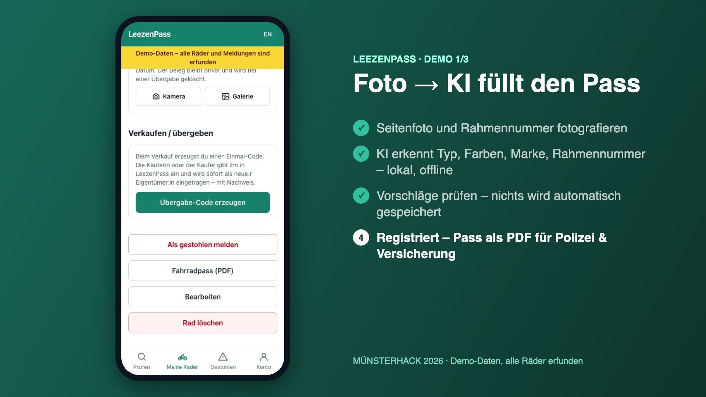
Notes:
1:30–2:10 (video 41 s, starts by itself, silent, loops; a click pauses it). Narrate over it: "I take one photo of my bike and one of the frame number. The AI recognises type, colours, brand and the frame number, locally, in seconds. I check the suggestions; nothing is saved automatically. Registered, and my bike pass is ready as a PDF for police and insurance." Mention once: all data in the demo is Demo-Daten.

Slide 6
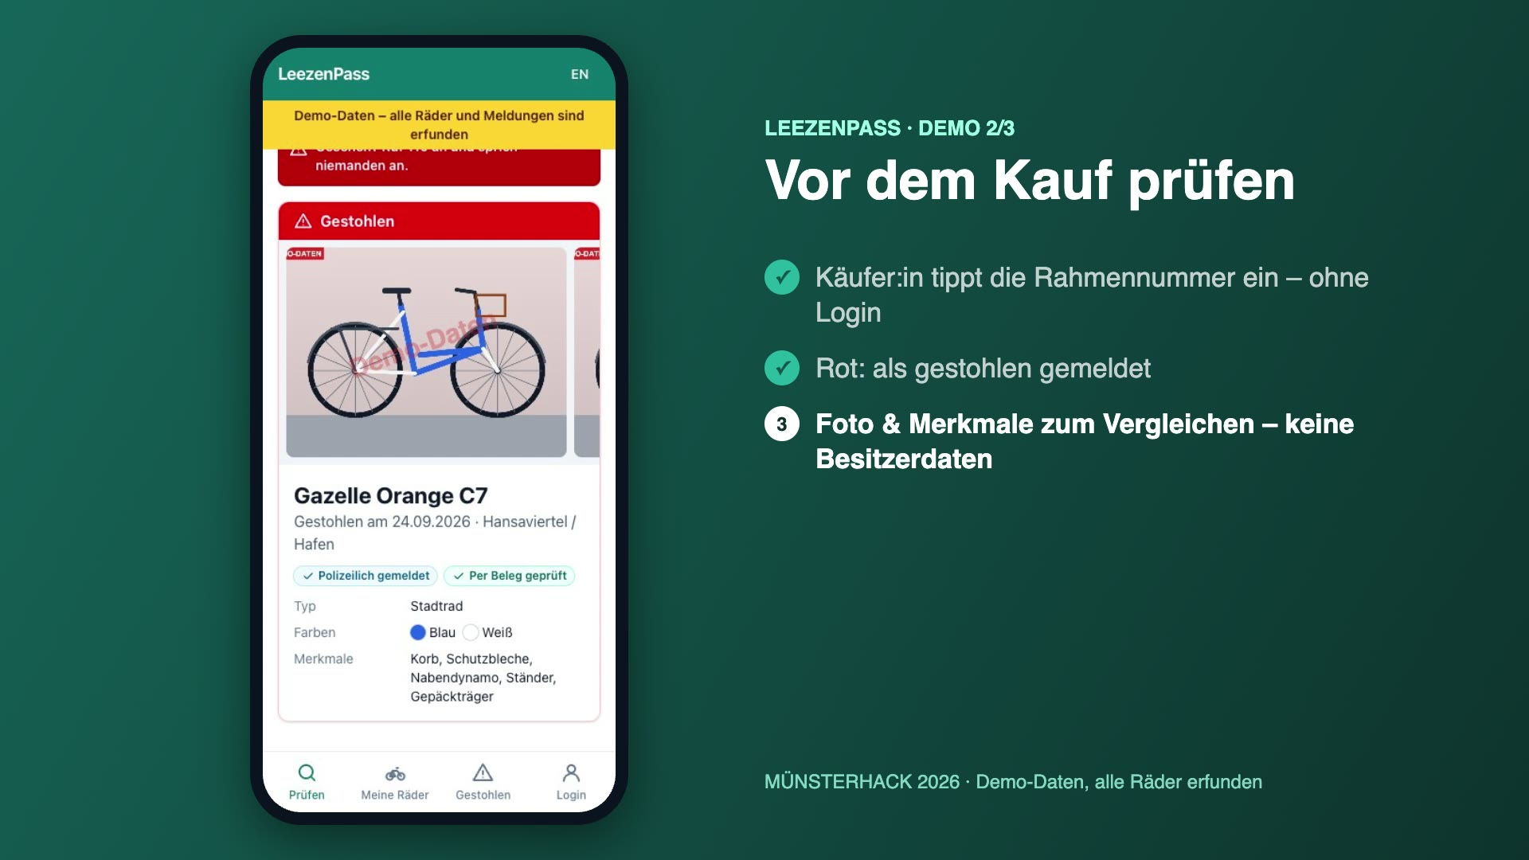
Notes:
2:10–2:40 (video 27 s). "Now I'm a buyer on Kleinanzeigen. No login, I just type the frame number. Red: this bike is reported stolen. Don't buy it, don't confront the seller, call 110. I can compare photo and features, but I never see who the owner is."

Slide 7
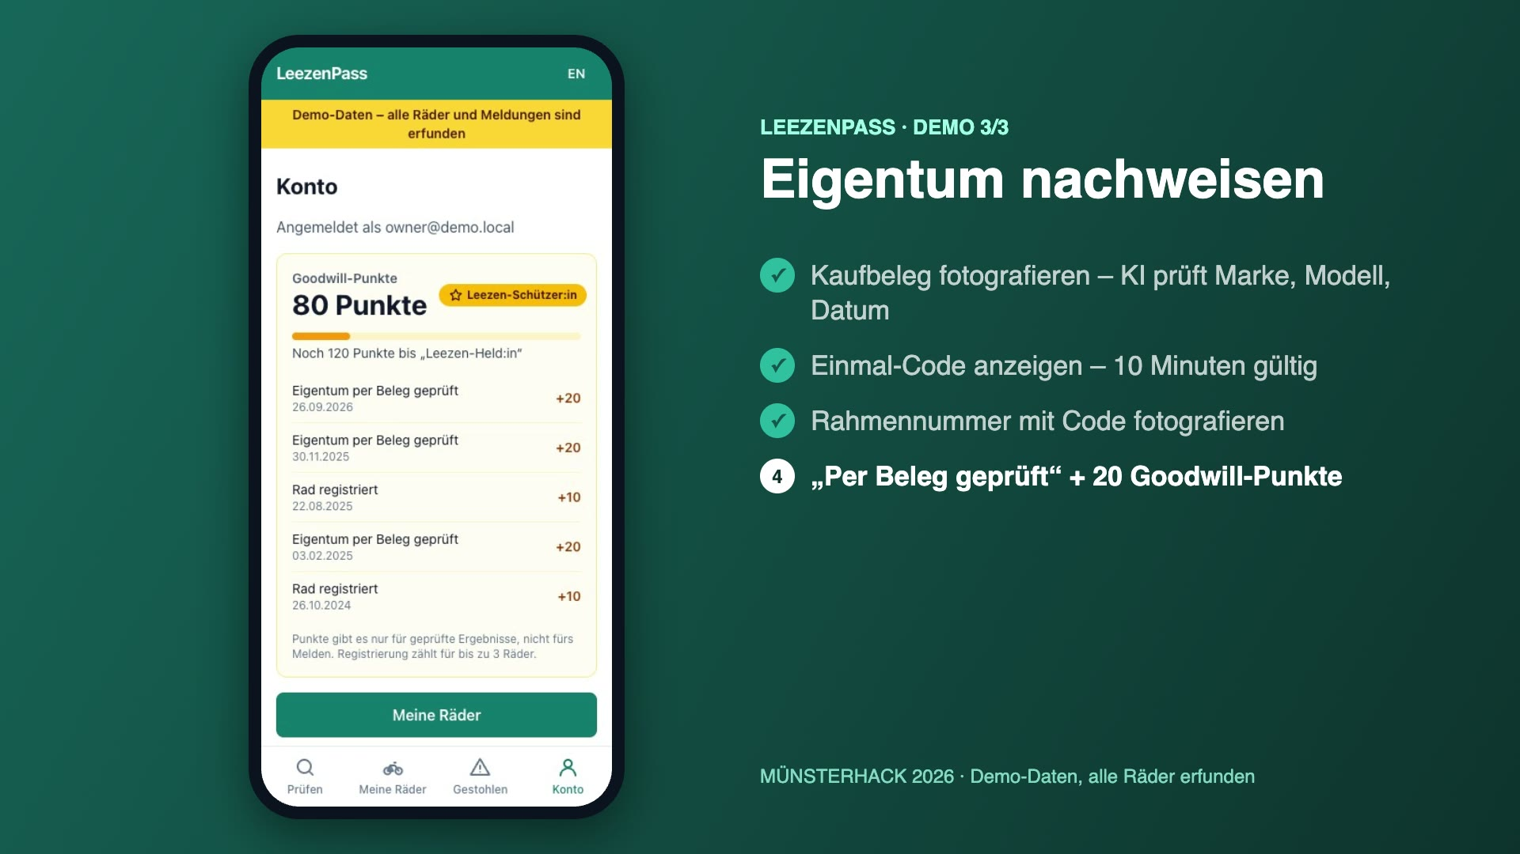
Notes:
2:40–3:25 (video 42 s). "How do we know the owner is really the owner? I photograph the receipt, and the AI checks brand, model and date. The app shows a one-time code, valid for 10 minutes. I photograph the frame number with the code next to it. Now the bike is 'Per Beleg geprüft', and I earn 20 goodwill points."

Slide 8




LEEZENPASS · TRUST AND PRIVACY
Trust built in, privacy by design
Three trust levels
Privacy rules
Selbst angegeben
The check never reveals that a clean bike is registered.
Registered with a verified email
Thief registers first? It stays "self-declared"; the owner claims it back with the receipt.
Per Beleg geprüft
Receipt plus a photo with a 10-minute code
FEIN codes stored only as a hash; photo location data removed.
Von Partner bestätigt
Registered by a bike shop or at an ADFC event
No personal data on any public page.
MÜNSTERHACK 2026 · LeezenPass
Notes:
3:25–3:55. Answer the jury's doubts before they ask. "You might ask: what if a thief registers the bike first? Every bike has a visible trust level. Self-declared is just the start; 'Per Beleg geprüft' needs the receipt and a live photo with a code; the highest level comes from bike shops and ADFC coding events. A thief's entry stays self-declared, and the real owner can claim the bike back. And privacy is built in: the check never tells anyone that a clean bike is registered, and no personal data appears on public pages."

Slide 9




LEEZENPASS · ADOPTION
Getting every Leeze registered
Bike shops
ADFC coding
Students
Insurance
Register at purchase, fully verified from day one.
Register while the frame gets coded.
First-semester welcome through the AStA.
Partner idea: easier claims for registered bikes.
Goodwill points
Badges, "Leezen-Held:in des Monats" and planned partner perks. Only verified outcomes count, never raw reports.
Open source: ready for Göttingen and Freiburg, #2 and #3 in thefts per resident.
MÜNSTERHACK 2026 · LeezenPass
Notes:
3:55–4:25. "A registry is only useful if people use it. So we meet them where bikes change hands: bike shops register at purchase, the ADFC registers while coding frames, first-year students get it in their welcome pack, and we'd like to talk to insurers about easier claims. Goodwill points reward verified outcomes, not spam: 10 for registering, 20 for verified ownership, 10 via a partner. They turn into badges, a monthly 'Leezen-Held:in', and we plan partner perks like service discounts. And because it's open source, Göttingen and Freiburg, the next two cities on the list, can use it too."

Slide 10
LEEZENPASS · NEXT STEPS
Let's pilot LeezenPass in Münster
Stadt Münster · Fundfahrradstation
ADFC Münsterland
Daily export of found-bike frame numbers, so owners get notified.
Register bikes at the monthly coding appointments.
Polizei Münster · Prävention
Solution Enabler · DIGIFARM.MS
Recommend LeezenPass; officers check frame numbers.
Test it in Münster, then long-term hosting and care.
Who's in?
Adarsh · Niharika · Viola · Frank · Phillip
github.com/iamAdarshh/MunsterHack-LeezenPass
Notes:
4:25–4:55. "Here's what we'd like to do next: with the city, match found bikes at the Fundfahrradstation against stolen ones; with the ADFC, register bikes at their coding appointments; with the police, recommend LeezenPass and check frame numbers; and through the Solution Enabler Programme and DIGIFARM.MS, run it for real. We'd love to pilot this in Münster. Who's in?" Stop talking, smile, wait for applause.

Slide 11


LEEZENPASS · APPENDIX
What's built, what's next
Built this weekend
Planned
Digital bike pass with photos and PDF export
Partner accounts: bike shops, ADFC events
AI prefill from photos, running locally
Found-bike matching with Fundfahrradstation
Public check by frame number or FEIN code
QR tag with anonymous finder contact
Theft report and public stolen list
Community sightings matched to owners
Ownership transfer with a one-time code
Theft risk map and safe parking
Ownership proof: receipt + code photo
Leaderboard, referrals, district progress
Trust levels shown on every bike
Insurance and partner perks
Goodwill points and badges
Rollout to Göttingen and Freiburg
Privacy: FEIN hashed, photo GPS removed
German / English, demo-data mode
Notes:
Appendix, not part of the 5 minutes. Show it only in Q&A when someone asks "what does it do today?" or "what's real and what's mock?". "Everything on the left runs in the code you just saw, with demo data. Everything on the right is the roadmap and needs partners: the city for found bikes, bike shops and the ADFC for partner accounts."

